Slide 1
Project SDG Collab
ETI Assignment 2 Presentation
Yong Zong Han Ryan (S10219317A) • Ng Ray Zin (S10222457H) • Simon Kwek (S10228098J) • Zacharia Aslam (S10204144J) • Isabelle Pak Yi Shan (S10222456J)

Slide 2
Introduction
Project Details
Architecture Design
Demonstration

Slide 3
Introduction
Project Details
Architecture Design
Demonstration

Slide 4
OBJECTIVE
Implement a solution aligned with one of the United Nations' Sustainable Development Goals, while integrating Cloud Native concepts learned

Slide 5
TARGET SDG
SDG 17:
Partnerships for the Goals

Slide 6
SOLUTION
SDG COLLAB
Web application connects local non-governmental organizations (NGOs) for collaborative projects.

Slide 7
Introduction
Project Details
Architecture Design
Demonstration

Slide 8
MAIN FEATURES
Project Coordination
Task Management
Resource Sharing
Forum Discussions

Slide 9
MICROSERVICE
Task Management
Resource Sharing
Project Coordination
Forum Discussions
Search
Organization Profile
User Profile

Slide 10
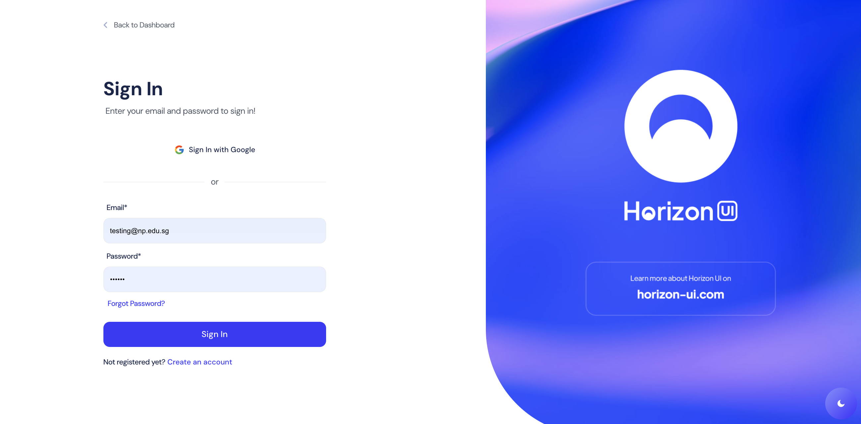
USER PROFILE MICROSERVICE
By: Ray Zin
Auth svc
Allows users to login via credentials or google
Service saves user data into firestore
Allows user to sign up

Slide 11
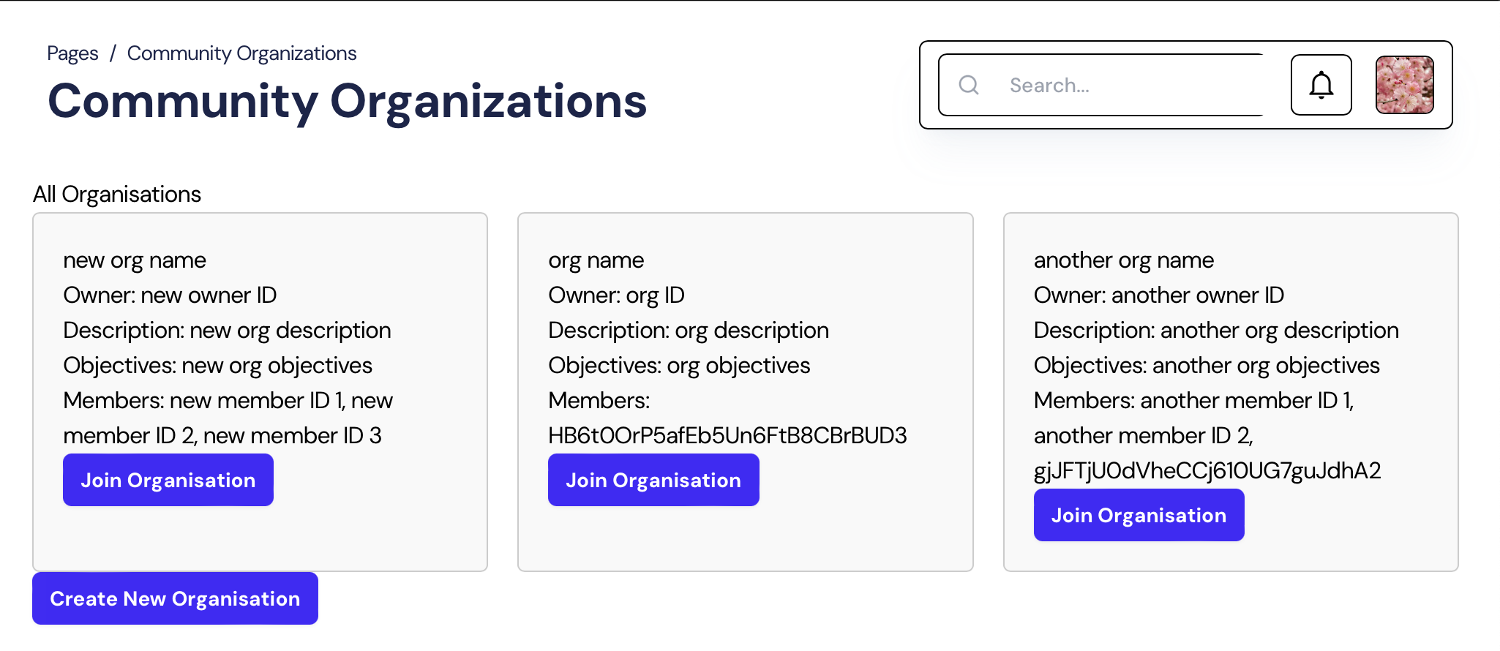
ORGANIZATION MICROSERVICE
By: Isabelle
Features:
Allows users to create organisations with the organization name, description and objectives (owners)
Allows users to join organisations (members)
Allows owners to modify organisation information

Slide 12
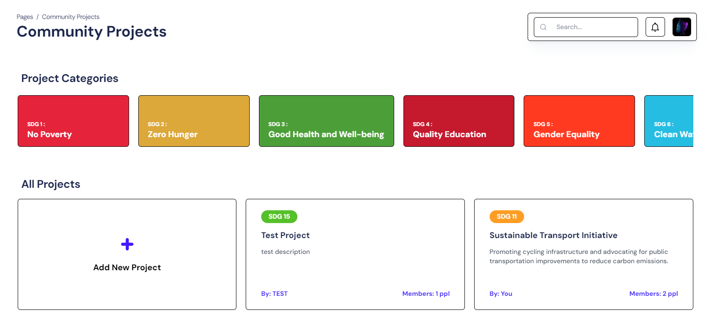
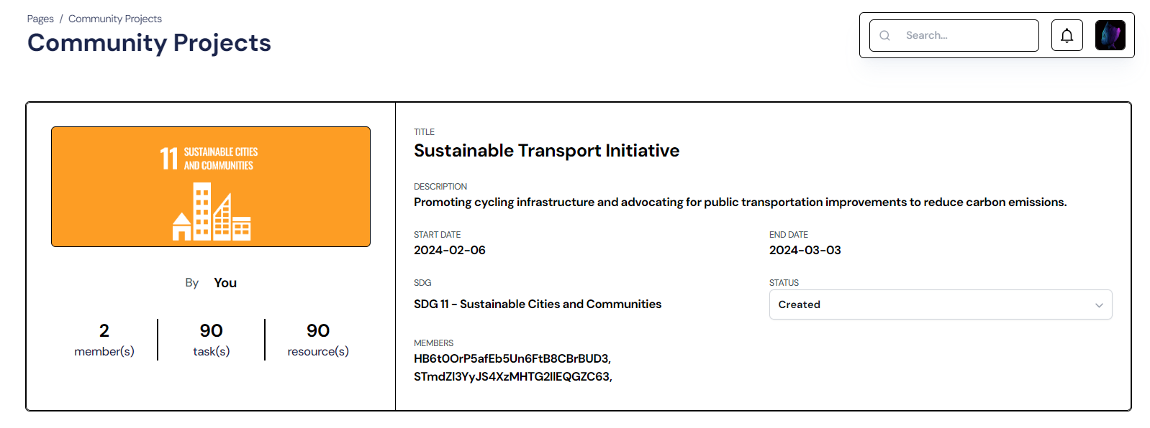
PROJECT MICROSERVICE
By: Ryan
Features:
Allow users to create new projects with relevant details such as name, description, start date, end date and status and the corresponding SDG.
Allow users to become members of the project and view the project resources.

Slide 13
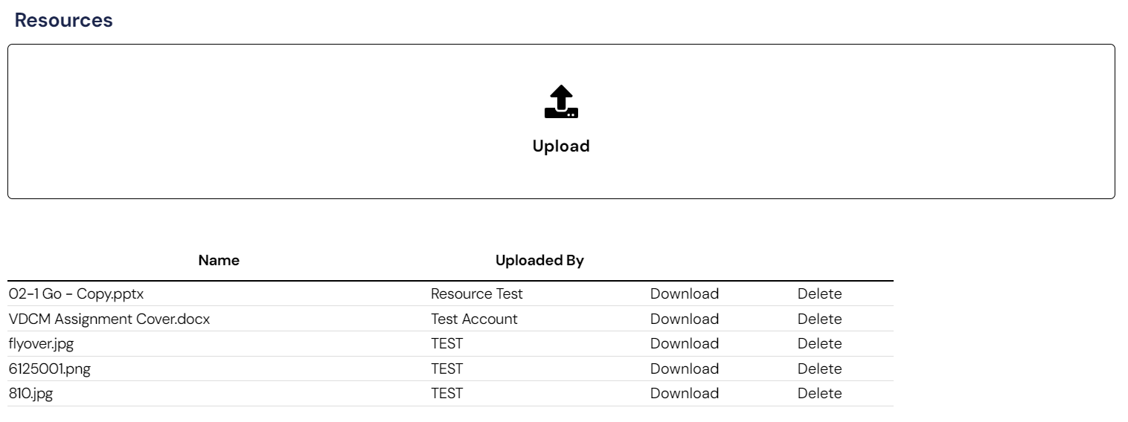
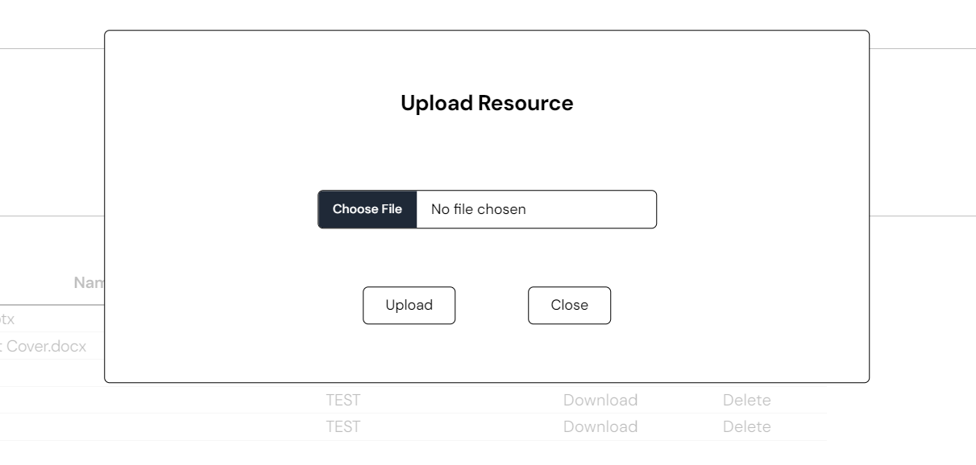
RESOURCE MICROSERVICE
By: Simon
Features:
Allows project members to view the list of resources (e.g. images, documents) for that project
Allows project members to upload, download or delete the project resources

Slide 14
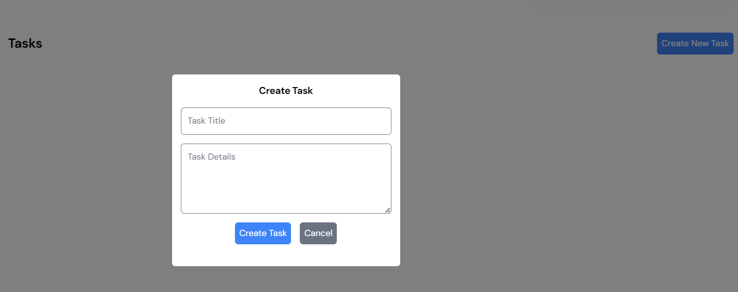
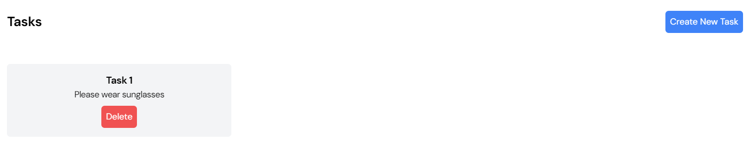
TASK MICROSERVICE
By: Zac
Features:
Allows NGOs to add/delete task to projects.
This will allow NGOs to create tasks which will be for enrolled users in a project

Slide 15
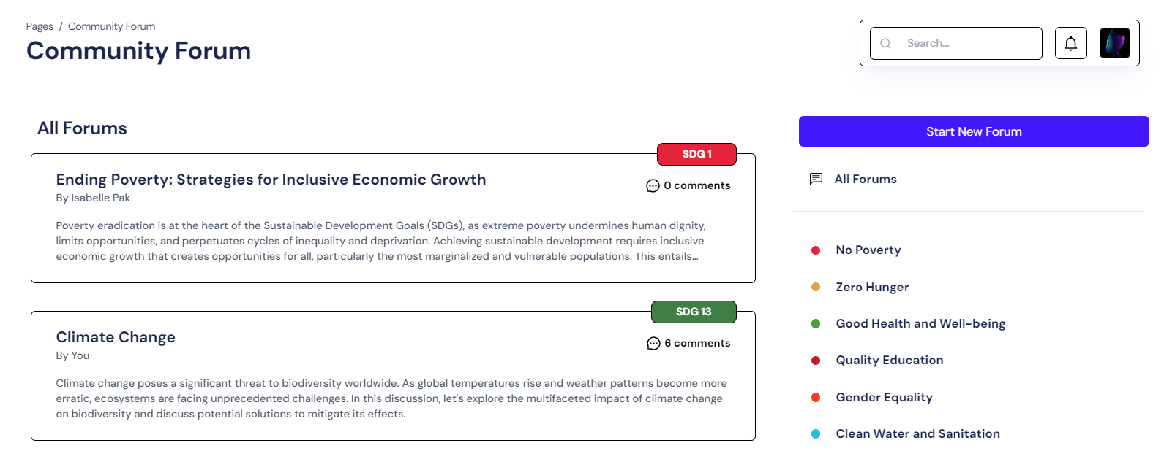
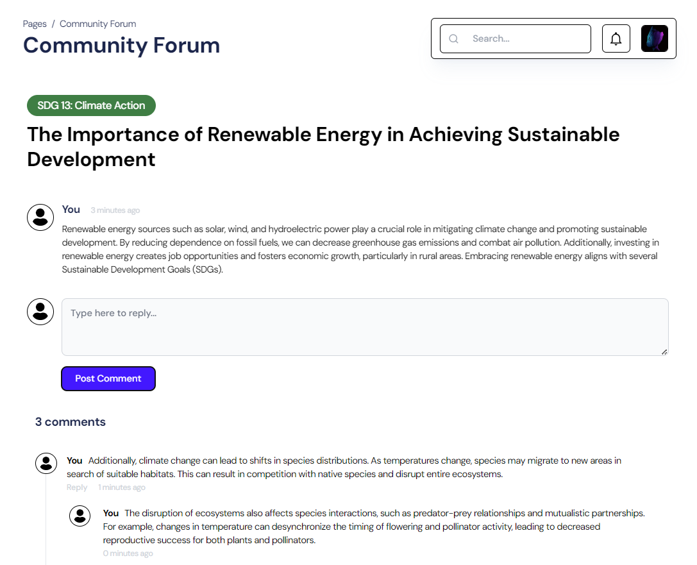
FORUM MICROSERVICE
By: Ryan
Features:
Allows users to create new discussion threads on various topics related to the SDG.
Enables users to engage in discussions and share ideas by posting replies and comments.

Slide 16
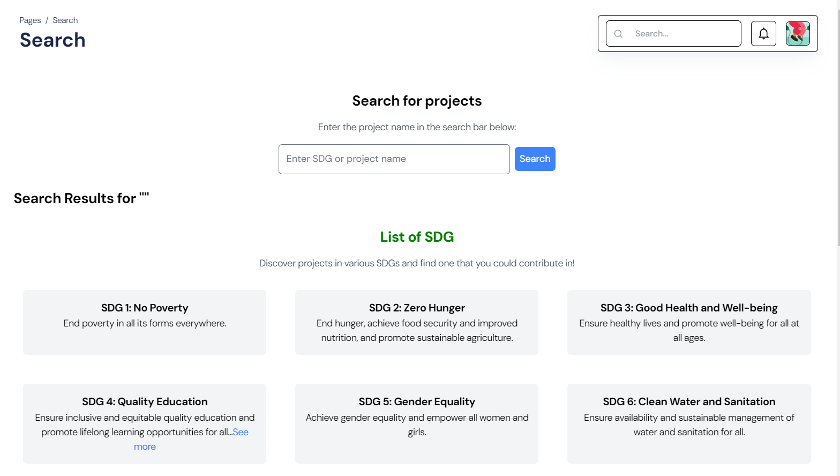
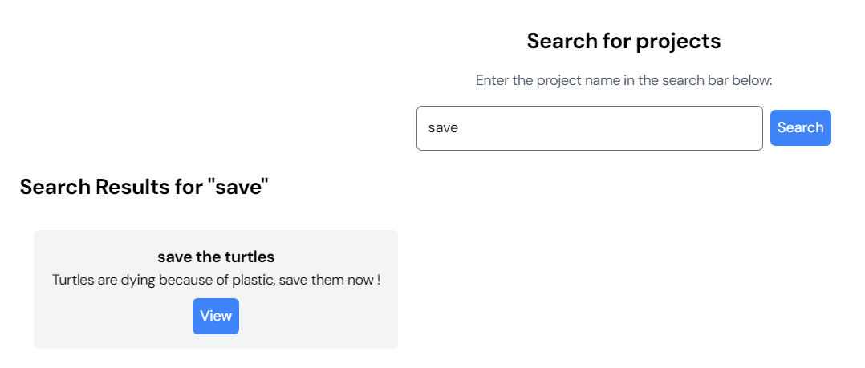
SEARCH MICROSERVICE
By: Zac
Features:
Allows users to search for project titles
Upon search, the project card will be displayed, and users will be able to see the project based on the respective project titles.

Slide 17
Introduction
Project Details
Architecture Design
Demonstration

Slide 18
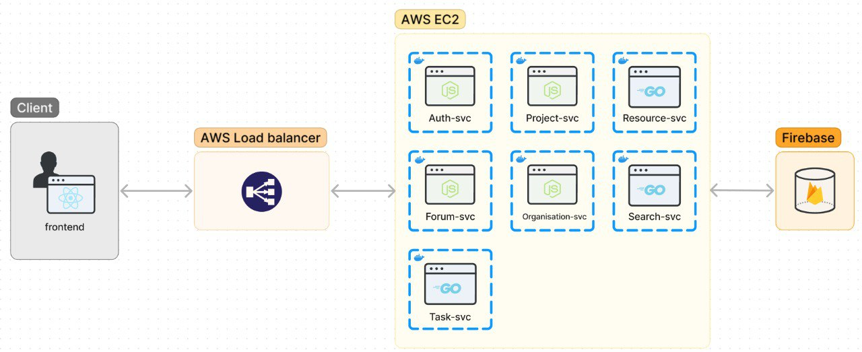

Slide 19
WHY THIS ARCHITECTURE?
Coherent
Reusable
Loosely Coupled
Scalable
Notes:
Coherent:
Encourages modular design: Microservices are designed to be self-contained, focusing on specific business functions.
Consistent communication: Defined interfaces and protocols ensure seamless communication between microservices.
Clear boundaries: Each microservice has a well-defined scope, reducing complexity and making the architecture more coherent.
Reusable:
Encourages componentization: Microservices are built as independent components, making them reusable across different applications.
Promotes service composition: Microservices can be combined to create new functionalities, enhancing reusability.
Facilitates library sharing: Common libraries and frameworks can be shared among microservices, promoting reuse of code and resources.
Loosely Coupled:
Independent deployment: Microservices can be deployed and updated independently, reducing dependencies and minimizing disruptions.
Flexible scaling: Individual microservices can be scaled independently based on demand, without affecting other parts of the system.
Decentralized control: Each microservice manages its own data and logic, reducing interdependencies and promoting autonomy
Scalable:
Horizontal scalability: Microservices architecture enables easy horizontal scaling by adding more instances of individual microservices to handle increased load.
Elasticity: The ability to dynamically adjust resources allocated to each microservice allows for efficient scaling up or down in response to fluctuating demand.
Granular scaling: Fine-grained control over scaling enables optimizing resource allocation based on the specific needs of each microservice, improving overall system performance and efficiency.

Slide 20
CLOUD NATIVE APPLICATION ARCHITECTURE CONCEPTS
Containerization
Microservice
API Communication

Slide 21
Containerization
smallest compute unit in a cloud-native application

pack the microservice code with their respective dependencies, such as the resource files, libraries, and scripts that the main application requires to run in cloud-native systems

applications run independently of the underlying operating system and hardware

deploy cloud-native applications on premises, on cloud infrastructure, or on hybrid clouds
Notes:
Containers are the smallest compute unit in a cloud-native application. They are software components that pack the microservice code and other required files in cloud-native systems. By containerizing the microservices, cloud-native applications run independently of the underlying operating system and hardware. This means that software developers can deploy cloud-native applications on premises, on cloud infrastructure, or on hybrid clouds. Developers use containers for packaging the microservices with their respective dependencies, such as the resource files, libraries, and scripts that the main application requires to run.

Slide 22
Microservices
small, independent software components that collectively perform as complete cloud-native software.

focuses on a small, specific problem.

loosely coupled, which means that they are independent software components that communicate with each other.

changes to the application are made by working on individual microservices allowing the application to continue to function even if one microservice fails.
Notes:
Simon
Microservices are small, independent software components that collectively perform as complete cloud-native software. Each microservice focuses on a small, specific problem. Microservices are loosely coupled, which means that they are independent software components that communicate with each other. Developers make changes to the application by working on individual microservices. That way, the application continues to function even if one microservice fails.

Slide 23
API Communication
method that two or more software programs use to exchange information.

use APIs to bring the loosely coupled microservices together.

API tells you what data the microservice wants and what results it can give you, instead of specifying the steps to achieve the outcome.
Notes:
Simon
Application Programming Interface (API) is a method that two or more software programs use to exchange information. Cloud-native systems use APIs to bring the loosely coupled microservices together. API tells you what data the microservice wants and what results it can give you, instead of specifying the steps to achieve the outcome.

Slide 24
BENEFITS OF CLOUD NATIVE ARCHITECTURE
fewer computing resources than conventional application deployment

deploy them almost instantly

scale the cloud computing resources your application requires more efficiently
Notes:
By using the cloud-native approach, software developers break the functionalities into smaller microservices. This makes cloud-native applications more agile as these microservices work independently and take minimal computing resources to run.

Slide 25
BENEFITS TO BUSINESSES
Increase Efficiency
Developers use automated tools, cloud services, and modern design culture to build scalable applications rapidly.

Reduce Cost
companies don't have to invest in the procurement and maintenance of costly physical infrastructure.

Ensure Availability
Feature updates do not cause downtime and companies can scale up app resources during peak seasons to provide a positive customer experience.
Notes:
Increase efficiency
Cloud-native development brings along agile practices like DevOps and continuous delivery (CD). Developers use automated tools, cloud services, and modern design culture to build scalable applications rapidly.
Reduce cost
By adopting the cloud-native approach, companies don't have to invest in the procurement and maintenance of costly physical infrastructure. This results in long-term savings in operational expenditure. The cost savings of building cloud-native solutions might also benefit your clients.
Ensure availability
Cloud-native technology allows companies to build resilient and highly available applications. Feature updates do not cause downtime and companies can scale up app resources during peak seasons to provide a positive customer experience.

Slide 26
Introduction
Project Details
Architecture Design
Demonstration

Slide 27
FURTHER EXPLORATION
Serverless Integration
Container Orchestration – K8s
API Communication
Micro Frontends
Continuous Delivery Pipeline
Notes:
Future enhancements to a microservices project could include:
Container Orchestration: Implementing a container orchestration platform such as Kubernetes to automate deployment, scaling, and management of containerized applications.
Service Mesh Integration: Introducing a service mesh like Istio to enhance communication, security, and observability between microservices.
Serverless Integration: Leveraging serverless computing for specific microservices to optimize resource utilization and reduce operational overhead.
Event-Driven Architecture: Evolving towards an event-driven architecture using tools like Apache Kafka or AWS EventBridge to enable asynchronous communication and decouple microservices further.
Continuous Delivery Pipeline: Implementing a robust CI/CD pipeline to automate testing, deployment, and monitoring processes, ensuring rapid and reliable delivery of updates.
Micro Frontends: Adopting a micro frontend architecture to enable independent development and deployment of user interface components, enhancing agility and scalability.
Data Partitioning: Implementing strategies for data partitioning or sharding to optimize data management and scalability as the application grows.
Machine Learning Integration: Introducing machine learning capabilities into microservices for tasks such as predictive analytics, personalization, or anomaly detection.
Immutable Infrastructure: Transitioning towards immutable infrastructure patterns to improve consistency, reliability, and security of deployments.
Multi-Cloud Deployment: Extending deployment capabilities to multiple cloud providers or hybrid environments to enhance resilience and reduce vendor lock-in.

Slide 28
Thank You.

